Slide 1
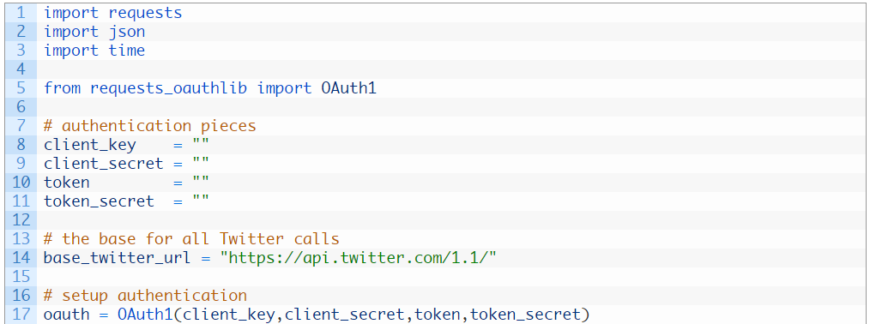
Unit 3: making your first call
all Twitter API calls are based on this URL so rather than re-type it out each time we simple create a placeholder variable to hold it
the OAuth1 class is responsible for handling the authentication to the Twitter API based on our API keys

Slide 2
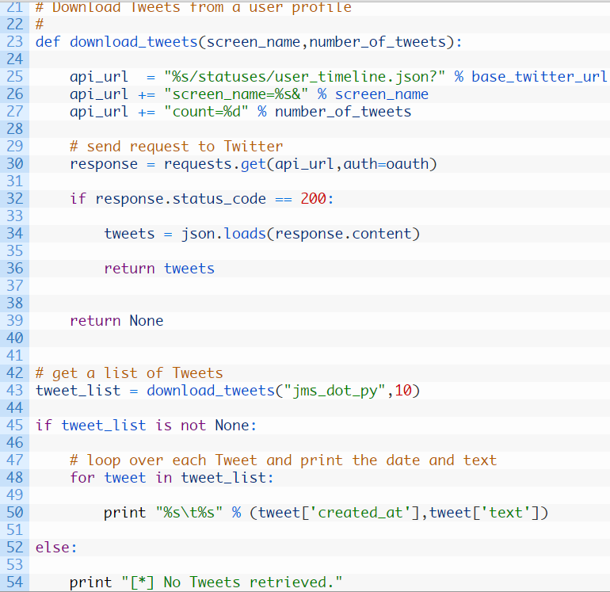
Defining our function
building our full request to the API by substituting in our values for the screen_name and count variables
send off the request to Twitter, passing along our OAuth authentication
if we successfully hit the API endpoint (32) then we parse the JSON (34) and return it (36) otherwise we return None to indicate that the function call failed
calls our download_tweets function passing in username jms_dot_py and we are asking for 10 Tweets
if a valid list of Tweets is returned (45) we loop over each Tweet (48) and we print out each Tweet with its date and the text of the tweet (50)
if there are no Tweets returned we simply print out a message

